Slide 1
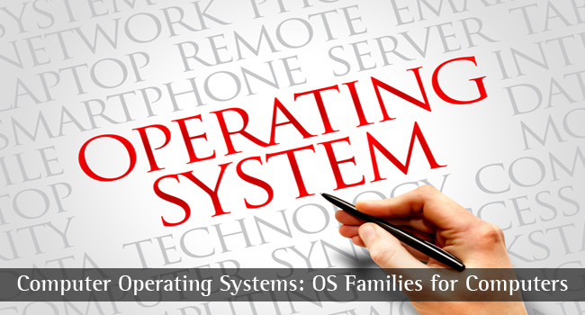
CS-3103 : Operating Systems : Sec-A (NB) :
Process Synchronization

Slide 2

Introduction
What is Process Synchronization?
Race Conditions
Critical Sections
Control Synchronization and Indivisible Operations
Synchronization Approaches
Structure of Concurrent Systems
Classic Process Synchronization Problems
Algorithmic Approach to Implementing Critical Sections
Semaphores
Monitors
Case Studies of Process Synchronization

Slide 3
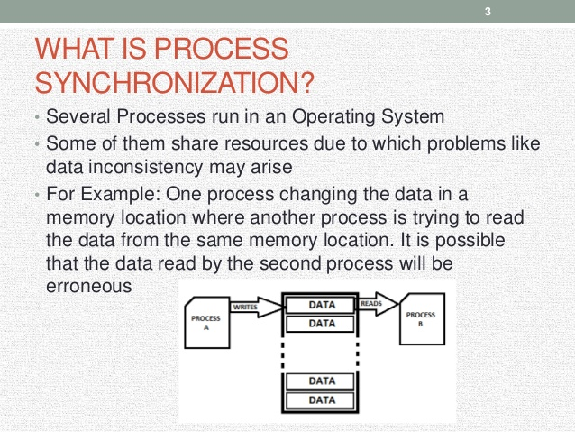

We have problem dealing with two concurrent processes trying to read and write data at the same time…..
State-II: P_{B}:
Read value of a from the same memory location at the same time instance t1
State-I: P_{A}:
a = a + 5 (in the process of being written in the memory location at time instance t1
P_{A}
P_{B}

Slide 4
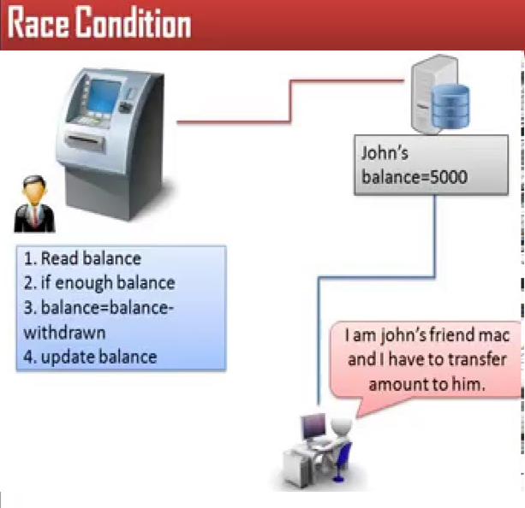
At the same time two write operations are happening????
What would be John’s balance????
Uncoordinated accesses to shared data (d_{s}) may affect consistency of data. In this example, d_{s} is John’s balance that is getting affected by John himself and his friend Mac.

Slide 5
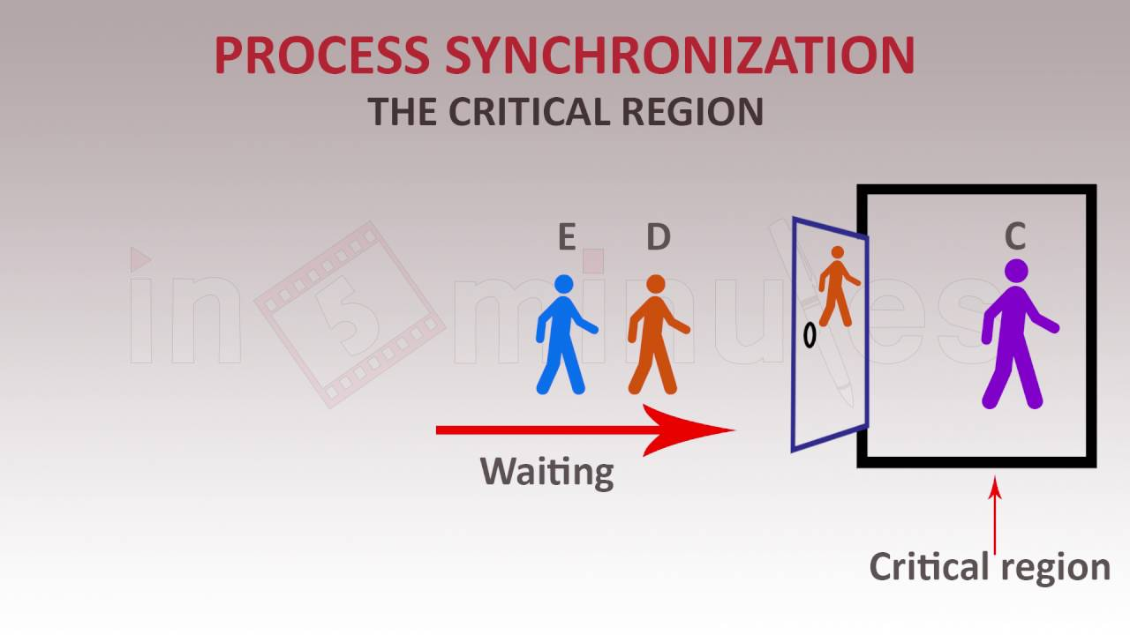
When C is in Critical Region, C has got full control, like, you are holding a token at bank counter for cash withdrawal. As long as the token is with you, O, E and D has to wait. When you release your token and signal that you are out of critical region, O, D (followed by E) would be able to gain access to CR one by one.

Slide 6

Process Synchronization, concurrent processes that are cooperating using critical section in Ticket booking….

Slide 7
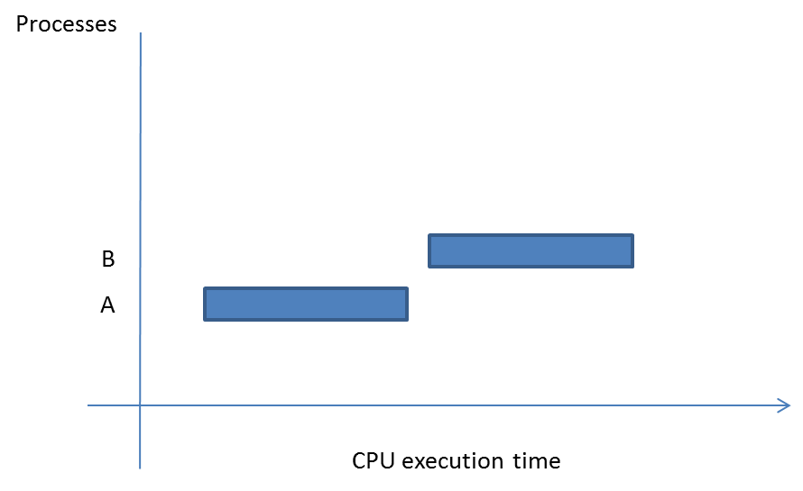
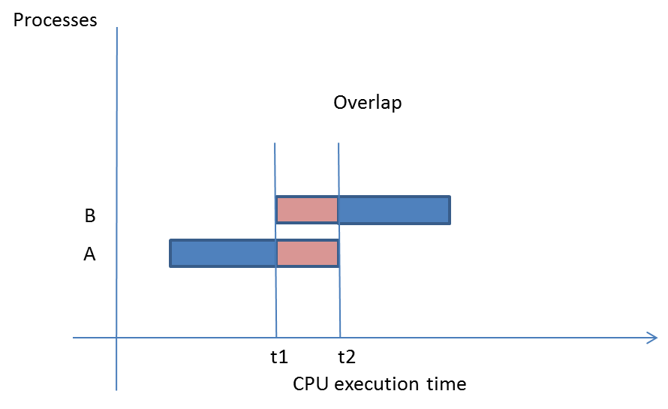
Concurrency
Multiprogramming and multitasking operating systems allow simultaneous residency of processes in main memory.
The resident processes can be divided into two types:
Serial processes : Two processes A and B are said to be serial when the execution of B starts only after the execution of A has stopped (fig A).
Concurrent processes have an overlap in their CPU execution time (fig B). It may be noted that for time duration t1 to t2, both processes, A and B, are using the CPU.
fig B : Concurrent processes
fig A : Serial processes

Slide 8
Categories of Concurrent Processes
Concurrent processes can be further divided into two categories:
Fully independent processes – two processes are independent if they do not affect each other or do not interect with each other. Example: when an application program does not share data with other executing processes, its called independent process.
Cooperating processes - when execution of processes is affected by each other and they share data

Slide 9
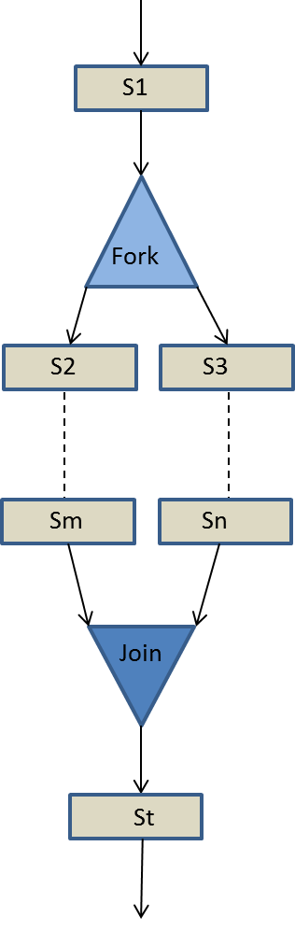
Programming Language Constructs for Concurrency
Fork and Join Construct: This construct specifies concurrency in a program whereby the control flow is split into two or more flows that can be executed in parallel. Later on, the two parallel flows join back into a single flow.
After Statement S1, the control flow has forked into two independent statement flows, ‘S2-Sm’ and ‘S3-Sn’. Both concurrent flows join at statement St.

Slide 10
Programming Language Constructs for Concurrency - Parbegin–Parend Construct
This is a structured construct that specifies concurrency in a given program.
The general format of this construct is given below:
parbegin
S1
S2
-
-
Sn
parend
Here, parbegin and parend are keywords, and the statements S1, S2, …..Sn are concurrent statements. Statements enclosed within the normal begin-end pair are considered sequential statements.

Slide 11
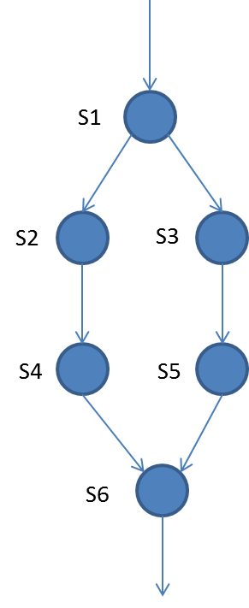
Example of parbegin and parend construct and precedence graph
begin
S1
parbegin
begin
S2;
S4;
end
begin
S3;
S5;
end
parend
S6
end
Within the ‘parbegin-parend’ pair, there are two sequential instruction streams, S2-S4 and S3-S5, that execute concurrently.

Slide 12
Before we turn to communication between processes, mutual exclusion, critical section (critical region) ➔ learn how to synchronize a set of cooperating and/or competing processes, let’s check Data Access & Control Synchronization & Race condition
The term process is a generic term for both a process and a thread.
What are Interacting processes? Processes Pi and Pj are interacting if the write_set of one of the processes overlaps the write_set or read_set of the other.
Process synchronization includes Data Access Synchronization and Control Synchronization.

Slide 13
Data Access Synchronization: Let a_{i} and a_{j} be operations on shared data d_{s} performed by two processes P_{i} and P_{j}.
f_{i}(d_{s}) represents the value of d_{s} resulting from changes, if any, caused by operation a_{i}.
Race conditions arise if processes access shared data in an uncoordinated manner, i.e., if the result of execution of a_{i} and a_{j} in processes P_{i} and P_{j} is other than f_{i}(f_{j}(d_{s})) or f_{j}(f_{i}(d_{s})).
Data access synchronization is used to access shared data in mutually exclusive manner.
Control Synchronization: This is needed if a process performs action a_{i} only after some other processes have executed a set of actions {a_{j}}.

Slide 14
Race Conditions
Uncoordinated accesses to shared data may affect consistency of data
Consider processes P_{i} and P_{j} that update the value of d_{s} through operations a_{i} and a_{j} , respectively:
Operation a_{i} : d_{s} := d_{s} + 10; Let f_{i}(d_{s}) represent its result
Operation a_{j} : d_{s} := d_{s} + 5; Let f_{j}(d_{s}) represent its result
What situation could arise if they execute concurrently?
Say, d_{s} has initial value 5. Then, f_{i}(d_{s}) is giving 15,and the concurrent operation, f_{j}(d_{s}) generates output 10!!! d_{s} cannot have two different values for the same data item….. We have to synchronize the operation of a_{i} and a_{j…..}

Slide 15
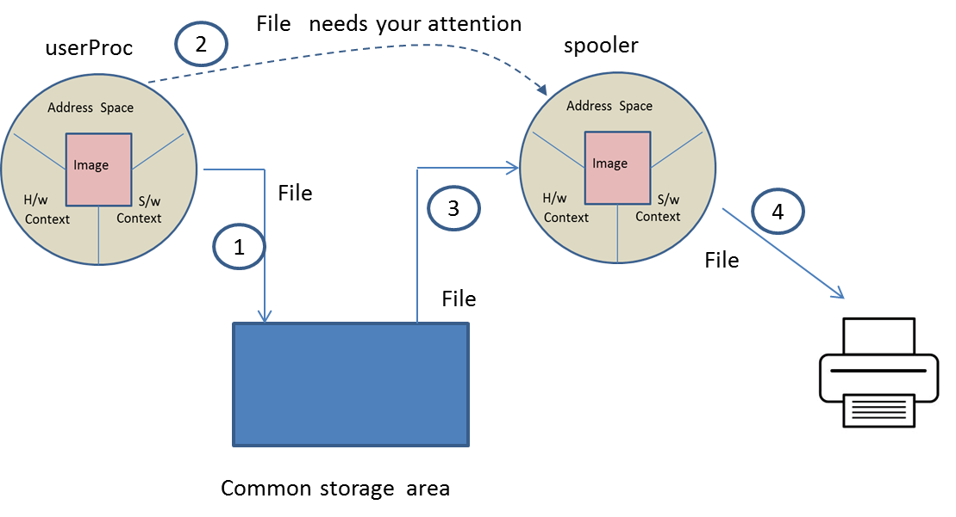
Communication Between Processes
In the case of cooperating processes, inter-process communication becomes a necessity. For instance, consider a situation where the printing jobs in an operating system are handled by a ‘spooler’ process. Now, as soon as a user process (say, userProc) is ready to print a file on a printer, it must store the file as a common storage area from where the spooler can also load the file. Thereafter, the ‘userProc’ must communicate to the ‘spooler’ process that there is a file that needs its attention….
Communicating processes

Slide 16
Communication Between Processes
It may be noted that the concurrent processes communicate with each other through shared variables and messages. Shared variables are common variables or data items which are accessible to communicating processes. Messages are information or signals which are exchanged by communicating processes.
In fact, the communication between concurrent processes becomes necessary in two situations, 1) Mutual Exclusion, 2) Synchronization.

Slide 17
Mutual Exclusion and Synchronization
In a computer system, the resources can also be divided into shareable and non-shareable resources.
Shareable resources: The resource that can be used by multiple processes concurrently. For example, CPU, read-only files, library files. A file in read mode can be concurrently read by many readers. The CPU can be time shared by the processes (RR-scheduling).
Non-shareable resources: Peripheral devices such as printer, plotter and writable files. Example: A plotter cannot be shared among processes. Unless the job of one process is completed, the job of another process cannot be taken by the plotter. Similarly, two users cannot be allowed to write on the same file at the same time.

Slide 18
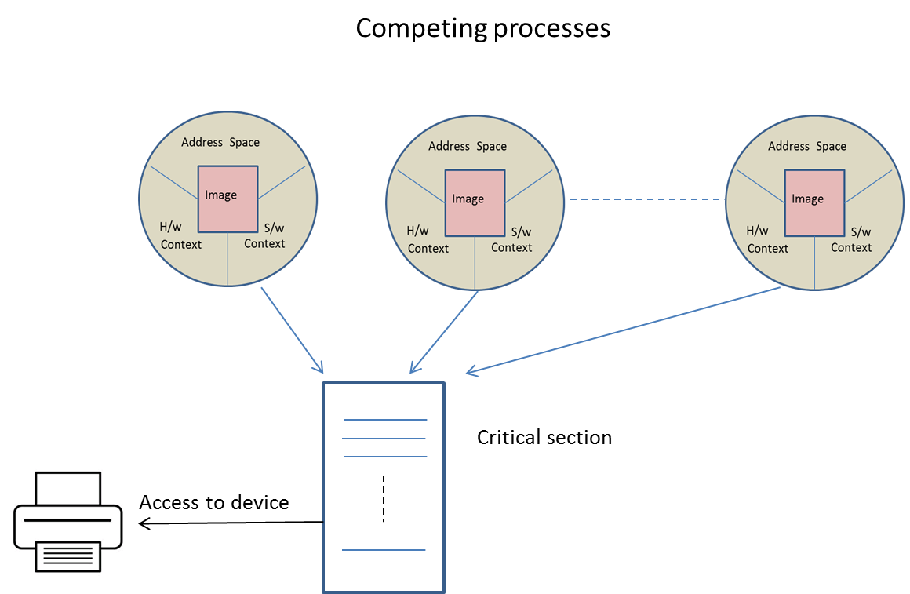
Key points regarding ➔ Mutual Exclusion and Synchronization
A sharable (d_{s}) or non-sharable resource should be protected so that only one process is able to access it at a time, and other processes must wait for their turn to use the resource.
The operating system guards access to shareable and non-shareable resources using a piece of code called critical section (CS). This means that when a process desires to access a resource, it must execute the code written within the CS that guards the resource as shown in Fig. AA.
Fig. AA

Slide 19
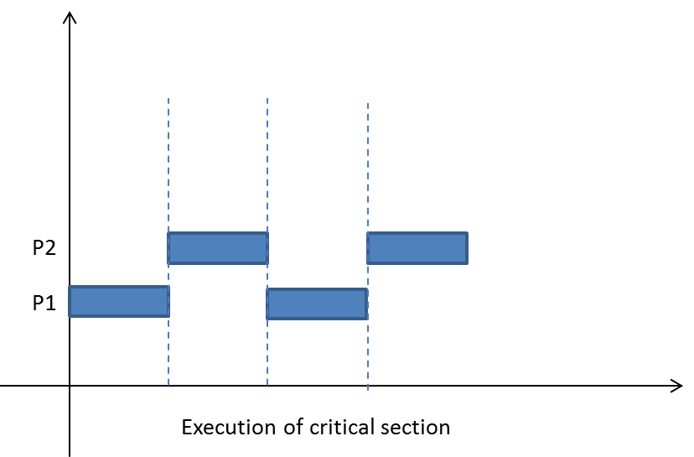
Management of Critical Sections (CS)
A critical section is a piece of code that accesses shared resources. The resources can be variables, data structures, and devices. The CS is executed as an atomic action, i.e., if two processes P1 and P2 both want t execute the CS, then only one is allowed to execute it, and the other is made to wait.
The general format is given below
{
Non-critical section
<entry section>
Critical Section
<exit section>
Non-critical section
}
Interleaved execution of resource
Interleaved execution of resource
The CS is guarded between two sections, the <entry> and <exit> sections.

Slide 20
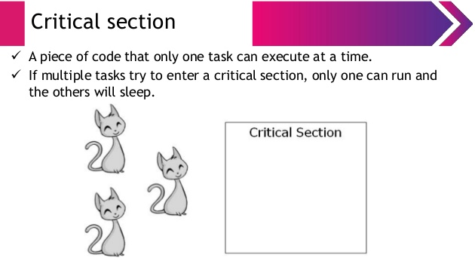


Slide 21
CS must satisfy the following correctness conditions:
Mutual exclusion: Only one process is allowed to enter into the critical section that guards a shared resource. At any moment, at MOST one process may execute a CS for a data item d_{s}.
Progress: If critical section is available for execution then only the processes can participate in the decision as to which process will enter into the critical section next. When no process is executing a CS for a data item d_{s}, one of the processes wishing to enter a CS for d_{s} will be granted entry.
Bounded wait: The policy has to be fair in the sense that no process should wait forever. After a process P_{i} has indicated its desire to enter a CS for d_{s}, the number of times other processes can gain entry to a CS for d_{s} ahead of P_{i} is bounded by a finite integer.
The progress and bounded wait properties together prevent starvation. Apart from correctness, a CS implementation should also guarantee that any process wishing to enter a CS would not be delayed indefinitely, i.e., starvation would not occur.

Slide 22
Properties of a Critical Section Implementation
When several processes wish to use critical sections for a data item ds, a critical section implementation must ensure that it grants entry into a critical section in accordance with the notions of correctness and fairness to all processes.
We know (last slide) three essential properties a critical section implementation to satisfy these requirements.
The mutual exclusion property guarantees that two or more processes will not be in critical sections for d_{s} simultaneously. Mutual exclusion ensures correctness of the implementation.
The second and third property (Progress and Bounded Wait) together guarantee that no process wishing to enter a critical section will be delayed indefinitely; i.e., starvation will not
occur.
The progress property ensures that if some processes are interested in entering critical sections for a data item ds, one of them will be granted entry if no process is currently inside any critical section for ds—that is, use of a CS cannot be “reserved” for a process that is not interested in entering a critical section at present. However, this property alone cannot prevent starvation because a process might never gain entry to a CS if the critical section implementation always favours other processes for entry to the CS.
The bounded wait property ensures that this does not happen by limiting the number of times other processes can gain entry to a critical section ahead of a requesting process Pi .
Thus the progress and bounded wait properties ensure that every requesting process will gain entry to a critical section in finite time; however, these properties do not guarantee a specific limit to the delay in gaining entry to a CS.

Slide 23
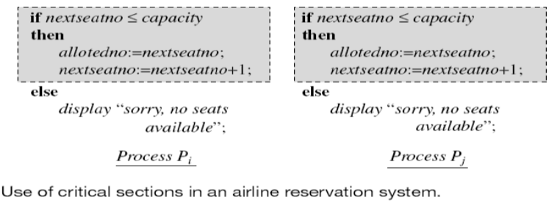

Slide 24
Control Synchronization and Indivisible Operations
Interacting processes need to coordinate their execution with respect to one another, to perform their actions in a desired order
A frequent requirement in process synchronization is that a process P_{i} should perform an action a_{i} only after process P_{j} has performed some action a_{j}.
This synchronization requirement is met using the technique of Signaling.

Slide 25
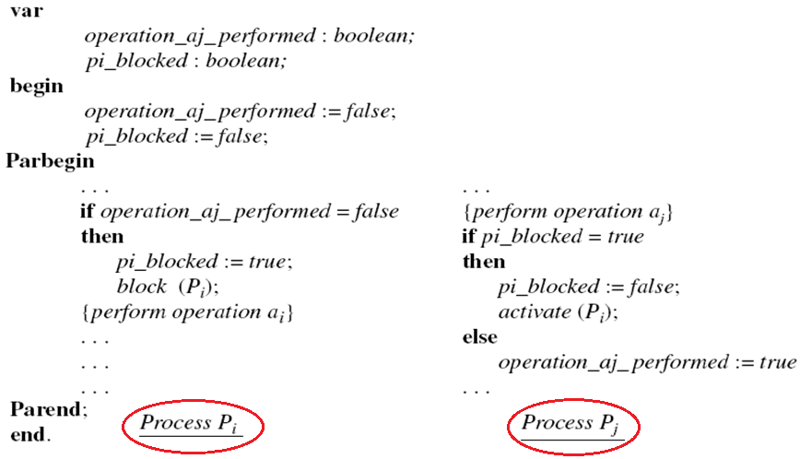
Control Synchronization and Indivisible Operations….

Slide 26
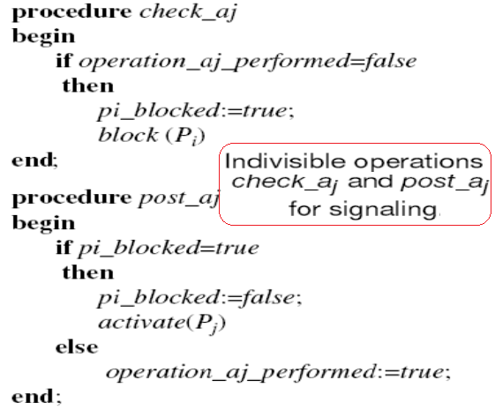
Control Synchronization and Indivisible Operations…
Indivisible Operation: An operation on a set of data items that cannot be executed concurrently either with itself or with any other operation on a data item included in the set.

Slide 27
Synchronization Approaches
Looping versus Blocking
Hardware Support for Process Synchronization
Algorithmic Approaches, Synchronization Primitives, and Concurrent Programming Constructs

Slide 28
Looping versus Blocking
Busy wait
is Not
desired…
In the while loop, the process checks if some other process is in a CS for the same data item. If so, it keeps looping until the other process exits its CS.
A busy wait is a situation in which a process repeatedly checks if a condition that would enable it to get past a synchronization point is satisfied. It ends only when the condition is satisfied. Thus, a busy wait keeps the CPU busy in executing a process even as the process does nothing! Lower priority processes are denied use of the CPU, so their response times suffer. System performance also suffers.

Slide 29
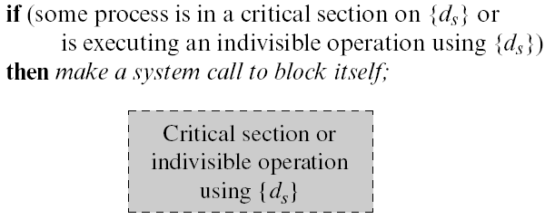
Looping versus Blocking (continued)
To avoid busy waits, a process waiting for entry to a CS is put in blocked state
Changed to ready state only when it can enter the CS
Process decides to loop or block
The above decision is subject to race conditions. Avoided through 1) Algorithmic approach, 2) Use of computer hardware features

Slide 30
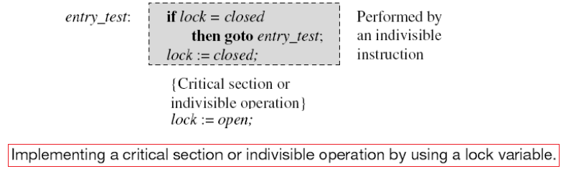
Hardware Support for Process Synchronization
Indivisible instructions
Avoid race conditions on memory locations
Used with a lock variable to implement CS and indivisible operations
entry_test performed with indivisible instruction
entry_test performed with indivisible instruction
Test-and-set (TS) instruction
Swap instruction

Slide 31
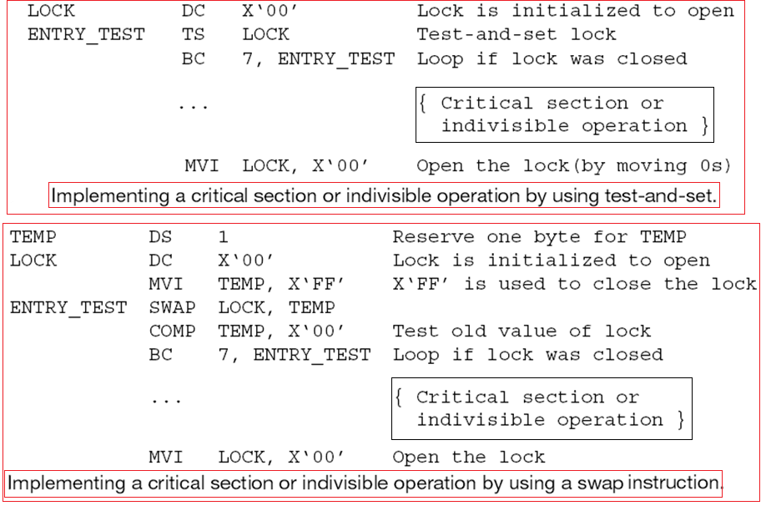
Hardware Support for Process Synchronization

Slide 32
Algorithmic Approaches, Synchronization Primitives, and Concurrent Programming Constructs
Algorithmic Approaches
For implementing mutual exclusion
Independent of hardware or software platform
Busy waiting for synchronization
Synchronization Primitives
Implemented using indivisible instructions
E.g., wait and signal of semaphores
Concurrent Programming Constructs
Monitors

Slide 33
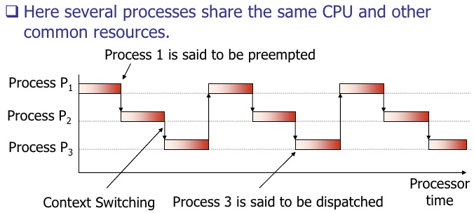
Structure of Concurrent Systems
Three key components:
Shared data : 1) Application data used and manipulated by processes;
2) Synchronization data
Operations on shared data: 1) Convenient unit of code which accesses and manipulates shared data → A synchronization operation is on synchronization data
Interacting processes: A snapshot of a concurrent system is a view of the system at a specific time instant
Processes entering the system following the order → P1 – P2 – P3. At time instant t1, CPU is allocated to P1, P2 and P3 are in ready queue. Then, like RR scheduling, P2 occupies CPU, and P1 is waiting (blocked), P3 ready state. This way, as time flows in x-axis, processes proceed with CPU and complete the execution.
t1
t2
t3
t4
t5
t6
t7

Slide 34
Classic Process Synchronization Problems
A solution to a process synchronization problem should meet three important criteria:
Correctness
Maximum concurrency
No busy waits
Some classic problems:
Producers-Consumers with Bounded Buffers
Readers and Writers
Dining Philosophers

Slide 35
CS must satisfy the following correctness conditions:
Mutual exclusion: Only one process is allowed to enter into the critical section that guards a shared resource. At any moment, at MOST one process may execute a CS for a data item d_{s}.
Progress: If critical section is available for execution then only the processes can participate in the decision as to which process will enter into the critical section next. When no process is executing a CS for a data item d_{s}, one of the processes wishing to enter a CS for d_{s} will be granted entry.
Bounded wait: The policy has to be fair in the sense that no process should wait forever. After a process P_{i} has indicated its desire to enter a CS for d_{s}, the number of times other processes can gain entry to a CS for d_{s} ahead of P_{i} is bounded by a finite integer.
The progress and bounded wait properties together prevent starvation. Apart from correctness, a CS implementation should also guarantee that any process wishing to enter a CS would not be delayed indefinitely, i.e., starvation would not occur.

Slide 36
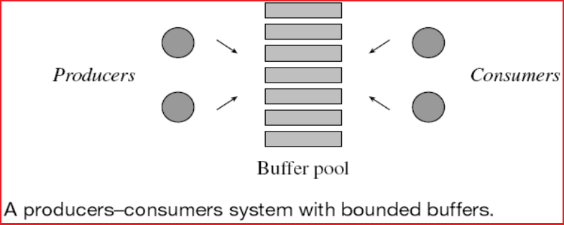
Producers-Consumers with Bounded Buffers
A producers-consumers system with bounded buffers consists of an unspecified number of producer and consumer processes and a finite pool of buffers.
Each buffer is capable of holding one record of information—it is said to become full when a producer writes into it, and empty when a consumer copies out a record contained in it; it is empty to start with.
A producer process produces one record at a time and writes it into the buffer.
A consumer process consumes information one record at a time.
Example of producers-consumers process:
A print service. A fixed size queue of print requests is the bounded buffer. A process that adds a print request to the queue is a producer process.

Slide 37
Producers-Consumers with Bounded Buffers
A solution must satisfy the following:
A producer must not overwrite a full buffer
A consumer must not consume an empty buffer
Producers and consumers must access buffers in a mutually exclusive manner
(Optional) Information must be consumed in the same order in which it is put into the buffers, i.e., in FIFO order

Slide 38
Producers-Consumers with Bounded Buffers…
Suffers from two problems:
Poor concurrency and busy waits
38

Slide 39
Producers-Consumers with Bounded Buffers…
Producer and Consumer processes access a buffer inside a critical section.
A producer enters its CS and checks to see whether an empty buffer exists. If so, it produces into the buffer, else it merely exits from its CS.
This sequence is repeated until it finds an empty buffer.
The boolean variable produced is used to break out of the while loop after the producer produces in the empty buffer.
Consumer makes repeated checks until it finds a full buffer to consume from.
The above design of producer-consumer problem suffers from busy-wait, because producer(consumer) keep on searching for empty(full) buffers.

Slide 40
Producers-Consumers with Bounded Buffers…
Improved outline with Signaling: Consider a producer-consumers system that consists of a single producer, a single consumer and a single buffer.
The operation check_b_empty performed by the producer blocks it if the buffer is full, while the operation post_b_full sets buffer_full to true and activates the consumer if the consumer is blocked for the buffer to become full.
Analogous operations check_b_full and post_b_empty are defined for use by consumer process.
The boolean flags producer_blocked and consumer_blocked are used by these operations to note if the producer or consumer process is blocked at any moment.

Slide 41
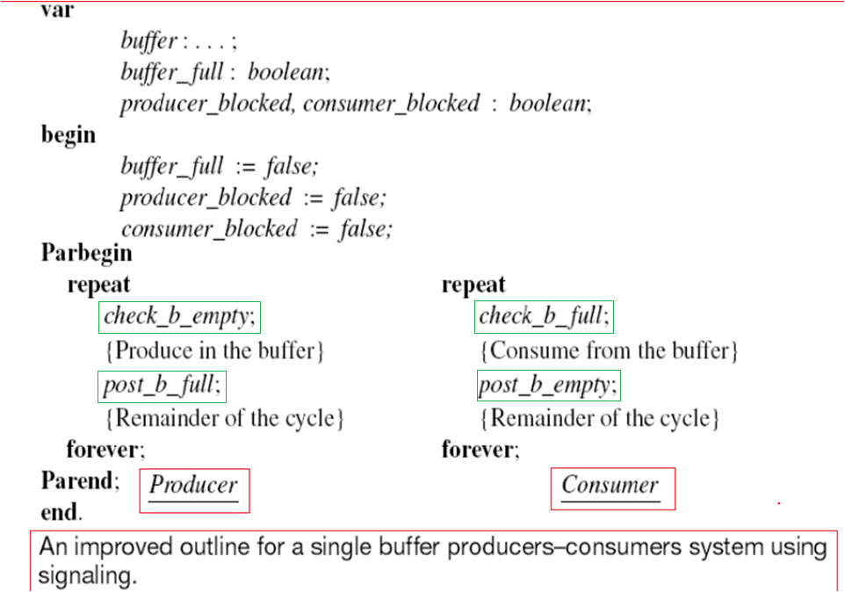
Producers-Consumers with Bounded Buffers…
41

Slide 42
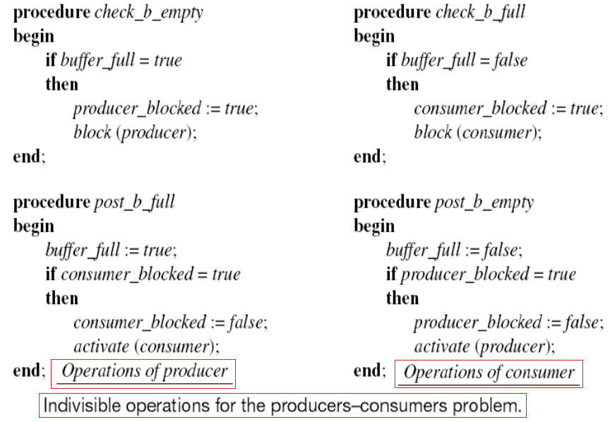
Producers-Consumers with Bounded Buffers…
42

Slide 43


Concurrent process which affect each other and share data are called:
a. Cooperating processes b. Independent processes
c. Serial processes d. None of the above
Ans. (a)
Concurrent processes cooperate with each other:
a. Information sharing b. Computation speed up
c. Convenience d. All of the above
Ans. (d)
Concurrent processes cooperate with each other:
a. Information sharing b. Computation speed up
c. Convenience d. All of the above
Ans. (d)

Slide 44

The variables whose contents get updated during execution of a statement are called:
a. Read variables b. Constants
c. Write variables d. None of the above
Ans: c
The concurrency of processes can be graphically represented by :
a. Wait for graph b. Precedence graph
c. Process state graph d. All of the above
Ans: b
The resources that can be shared by multiple processes concurrently are called :
a. Shareable resources b. Non-shareable resources
c. Consumable resources d. None of the above
Ans: a
Which resources may be protected from simultaneous access?
a. Shareable resources b. Non-shareable resources
c. Consumable resources d. None of the above
Ans: b

Slide 45

The act of exchanging signals among processes for information sharing, is called:
a. Critical section b. Mutual exclusion
c. Synchronization d. All of the above
Ans: c
The condition that allows only one process to enter the critical section is called:
a. Live-lock b. Mutual exclusion
c. Synchronization d. All of the above
Ans: b
A critical section must satisfy:
a. Correctness b. Progress
c. Fairness d. All of the above
Ans: d

Slide 46
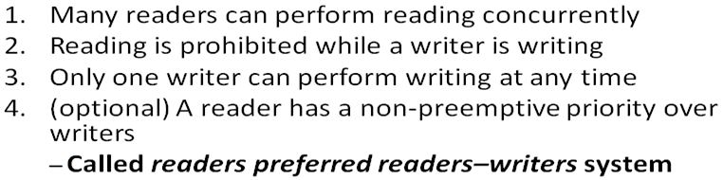
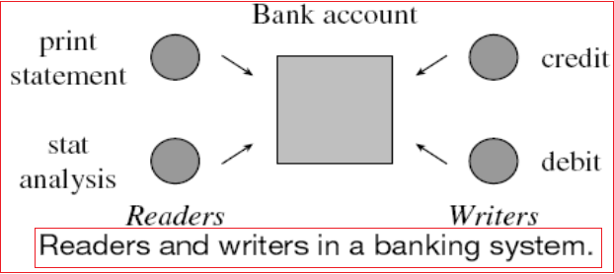
After Q-n-A session, let’s come back to Readers and Writers
A readers-writers system consists of a set of processes using some shared data.
A process that only reads the data is a reader; a process that modifies or updates it is a writer.
The correctness conditions for the readers-writers problem are :

Slide 47
Readers and Writers……
The readers and writers share a bank account. The reader processes print statement and stat analysis read the data from the bank account. Hence they can execute concurrently.
Credit and debit modify the balance in the account. Clearly only one of them should be active at any moment and none of the readers should be active when they modify the data.

Slide 48
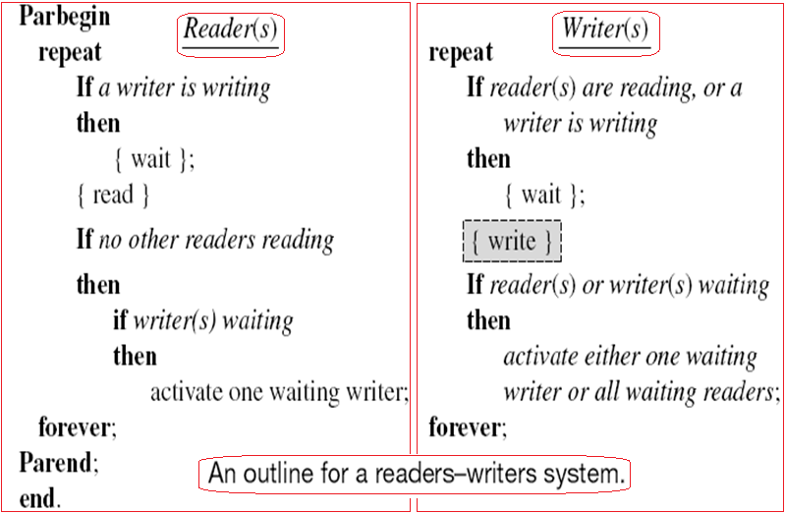
Readers and Writers……
CS
Fig. AB

Slide 49
Readers and Writers……
The synchronization requirements of readers-writers system is determined by analyzing its correctness conditions as follows:
Condition 3 requires that a writer should perform writing in a critical section. When it finishes writing, it should activate one waiting writer or activate all waiting readers. This can be achieved using a signaling arrangement.
From condition 1, concurrent reading is permitted. We should maintain a count of readers reading concurrently. When the last reader finishes reading, it should activate a waiting writer.
Based on Fig. AB, writing is performed in a CS. A CS is not used in a reader as that would prevent concurrency between readers. The outline in fig. AB, does not satisfy the bounded wait condition for both readers and writers, however, it provides maximum concurrency.

Slide 50
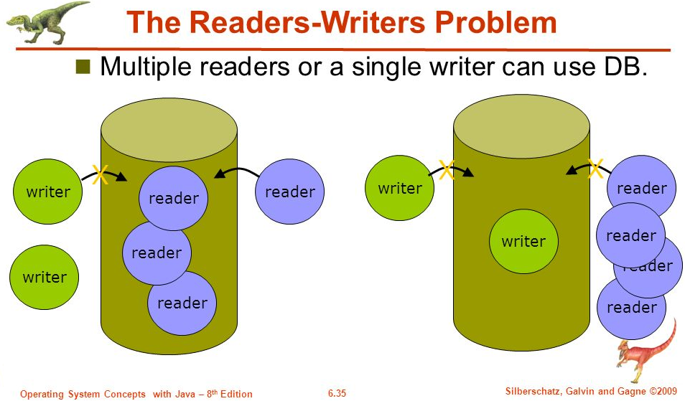
Condition 2 ➔
Reading is prohibited when a writer is writing….

Slide 51


Slide 52
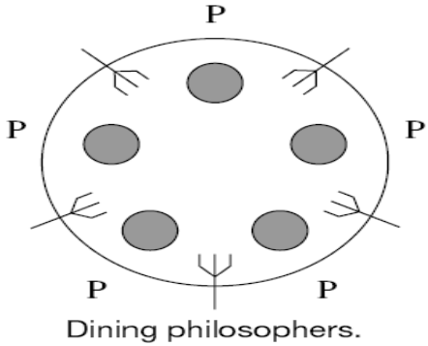
Dining Philosophers
Fig. AA
Five philosophers sit around a table thinking philosophical issues.
A plate of noodles is kept in front of each philosopher, and a fork is placed between each pair of philosophers (Fig. AA).
To eat, a philosopher must pick up the two forks placed between him and his immediate neighbors on either side, one at a time.
The problem is to design processes to represent the philosophers such that each philosopher can eat when hungry and none dies of hunger.
The correctness condition in the dining philosophers system is that a hungry philosopher should not face indefinite wait when he decides to eat.
The challenge is to design a solution that does not suffer from either deadlocks, where processes become blocked waiting for each other, or livelocks, where processes are not blocked but defer to each other indefinitely.
Consider the outline of a philosopher process Pi shown in Fig. A1, where we do not have the details of process synchronization.
…. Next slide…. With fig. A1….

Slide 53
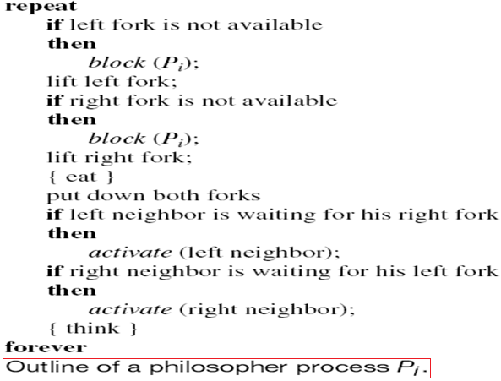
Dining Philosophers….
This solution is prone to deadlock, because if all philosophers simultaneously lift their left forks, none will be able to lift the right fork!!!
It also contains race conditions because neighbors might fight over a shared fork.
We can avoid deadlocks by modifying the philosopher process so that if the right fork is not available, the philosopher would defer to his left neighbor by putting down the left fork and repeating the attempt to take the forks sometime later.
This approach suffers from livelocks because the same situation may recur.
Fig. A1

Slide 54
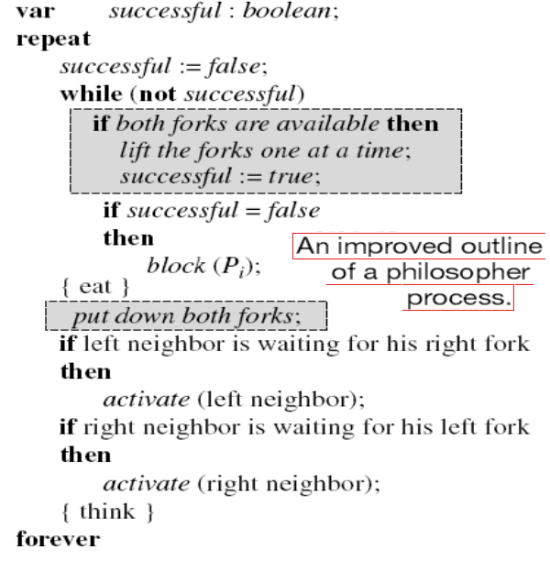
Dining Philosophers….
A philosopher checks availability of forks in a CS and also picks up the forks in the CS. Hence race conditions cannot arise.
This arrangement ensures that at least some philosopher(s) can eat at any time and deadlocks cannot arise.
A philosopher who cannot get both forks at the same time blocks himself.
However, it does not avoid busy waits because the philosopher gets activated when any of his neighbors puts down a shared fork, hence he has to check for availability of forks once again. This is the purpose of the while loop.
Fig. A2

Slide 55
Software Solutions for Critical Section ➔ Dekker’s Algorithm for Two-process CS Problem
Dekker proposed that in case of race condition let turn be used to break the tie.
This means that if a process (say P2) desires to enter the CS and finds that the other process (P1) is also interested in entering, and it is the turn of the other process (P1), then the previous process (P2) forgoes its claim and sets its state to false, enabling the other process (P1) to enter the CS.
Dekker’s algorithm is shown in Fig. A3 (slide 6.56).

Slide 56
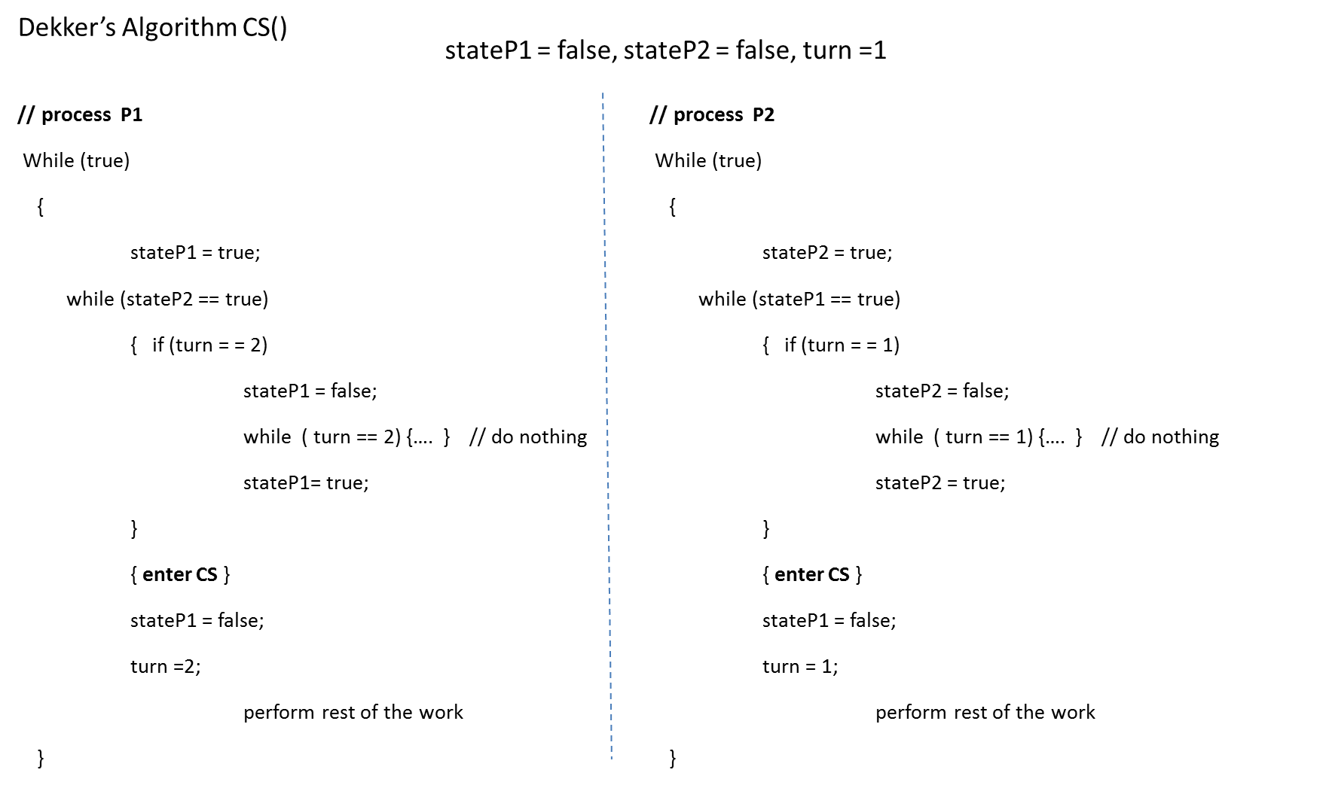
Dekker’s Algorithm for Two-process CS Problem
Fig. A3

Slide 57
Peterson’s Algorithm for Two-process CS Problem
The Dekker’s solution is correct and complete. Let us consider the following scenario: Assume that turn = 1.
P1 shows its interest in entering the CS. It sets ‘stateP1 = true’.
P1 is preempted and a context switch takes place with P2.
P2 shows its interest in entering the CS. It sets ‘stateP2 = true’.
P2 tries to enter the CS but finds that ‘stateP1 = true’ and also ‘turn == 1’, It sets ‘stateP2 = false’.
P2 is preempted and a context switch takes place with P1.
P1 tries to enter into CS and it finds that ‘stateP2 == false’ and therefore it enters the CS.
In Peterson’s algorithm, a process allows the other process too get into the CS by giving the turn to other process. The algo. is given in
Fig. A4

Slide 58
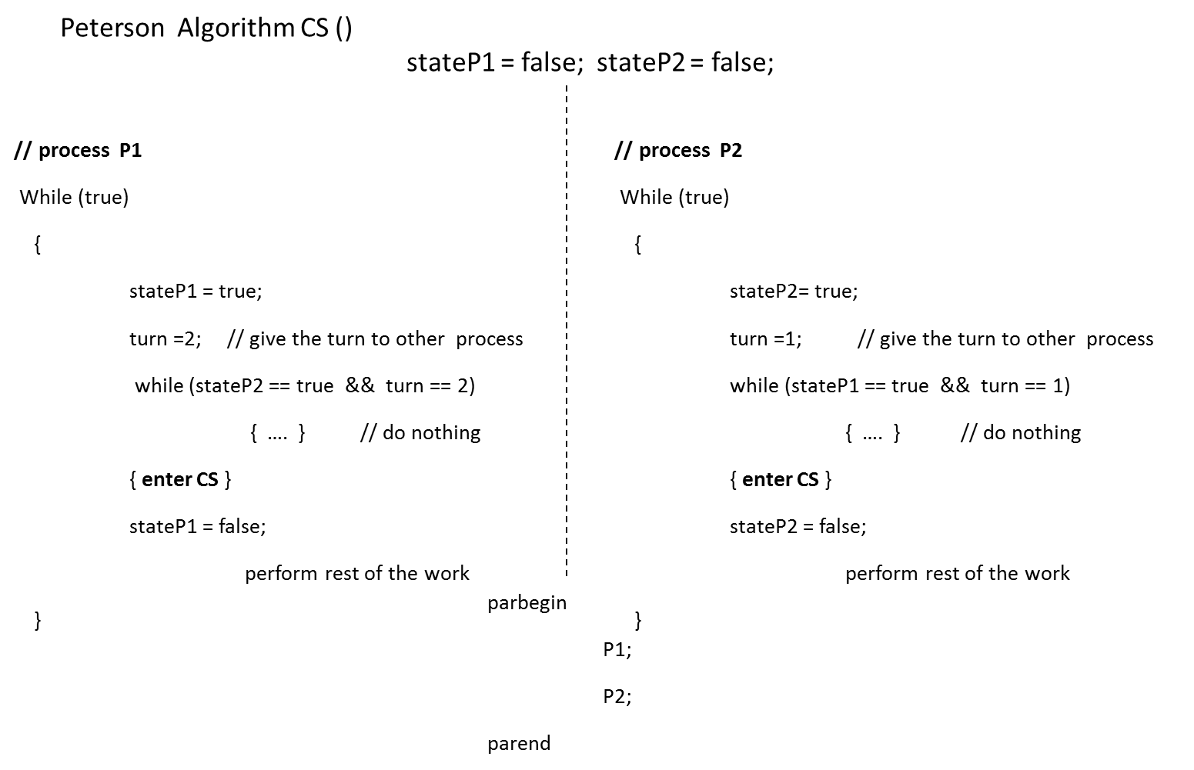
Peterson’s Algorithm for Two-process CS Problem
Fig. A4

Slide 59
Bakery’s Algorithm – Solution to the N-process CS Problem
Let us assume there are N processes.
Every process is allotted a number from 1..N.
If a process desires to enter the CS, it obtains a token from the system.
The system allots a pair of values (token[i], i) to the process, where token[i] is the token number of i^{th} process, and i is the process number.
The token number is so assigned that its value is one more than the highest token assigned thus far.
The token is not protected by the system and therefore there are chances that two processes, under race conditions, may get the same token number.
However, the process of obtaining the token is controlled by a boolean variable called choosing.
This algorithm uses a Boolean array called choosing[] and an integer array called token[].
All entries of the array choosing[] are initially set to false indicating that no process is choosing the token.
Similarly, all entries of the array token[] are initially set to 0 indicating that all processes are out of CS.

Slide 60
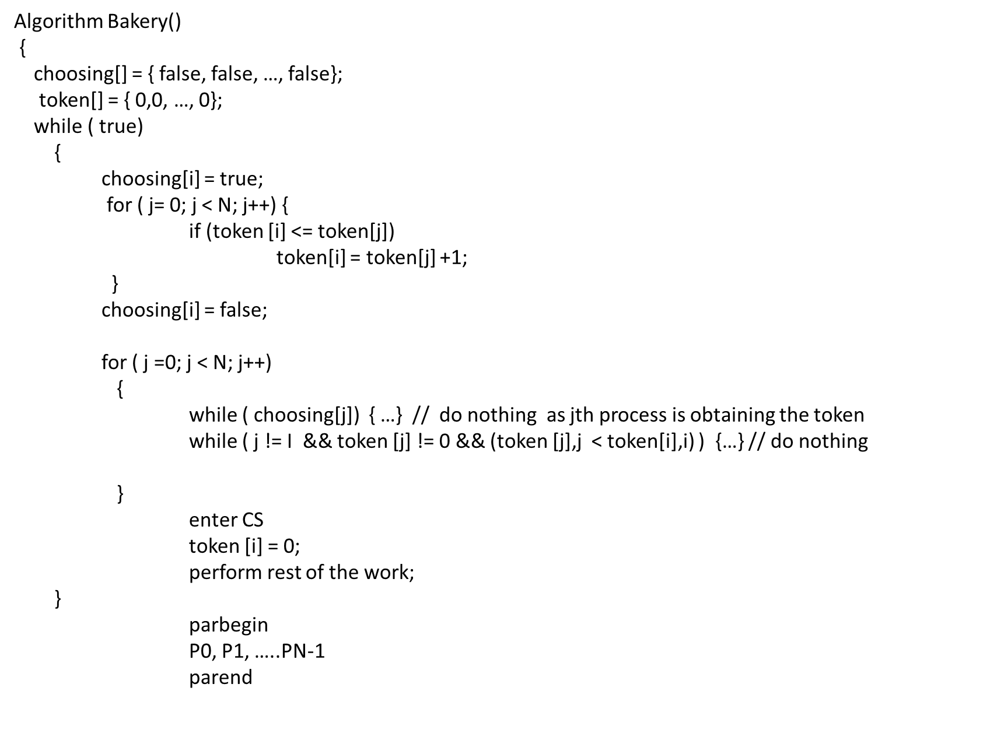
Bakery’s Algorithm – Solution to the N-process CS Problem
Fig. A5

Slide 61
Bakery’s Algorithm – Solution to the N-process CS Problem
Now, if a process Pi desires to enter the CS, it sets choosing[i] = true indicating that it is obtaining the token.
After obtaining the token it sets ‘choosing[i] = false’.
Once the token is obtained by the process, it tries to access the CS in the order of its token number.
Before entering the CS the process ensures that either the other processes have token numbers greater than its token value, or their token value is equal to 0, indicating that they are out of the CS.
Thus, this algorithm satisfies the following:
Correctness: Only one process enters the CS at a time.
Progress: If multiple processes are trying to enter the CS, one of them will eventually enter the CS.
Fairness: No process will wait indefinitely. A time will come for each process, when it becomes eligible and eventually enters the CS.
Generality: It works for N processes.

Slide 62


